Slide 1
GRADE 7 ACCELERATED · UNIT 3 · LESSON 4
Negative Exponent Law
MA.8.NSO.1.3
I can rewrite a power with a negative exponent using a positive exponent, and evaluate it.
Grade 7 Accelerated · Unit 3 · Lesson 4 — Negative Exponent Law
1

Slide 2




Warm-Up
1. Find the value:
2. Which is greater,
or 5.5?
3. Solve
4. What is the reciprocal of
? What is the opposite of
?
Grade 7 Accelerated · Unit 3 · Lesson 4 — Negative Exponent Law
2

Slide 3


Warm-Up
1. Find the value:
25
2. Which is greater,
or 5.5?
5.5
3. Solve
x = −7
4. What is the reciprocal of
? What is the opposite of
?
and
Grade 7 Accelerated · Unit 3 · Lesson 4 — Negative Exponent Law
3

Slide 4
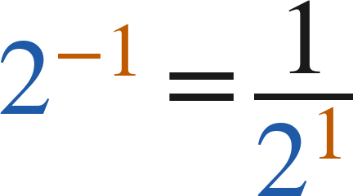
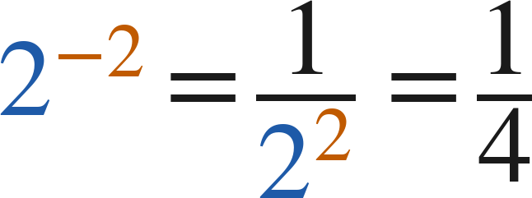
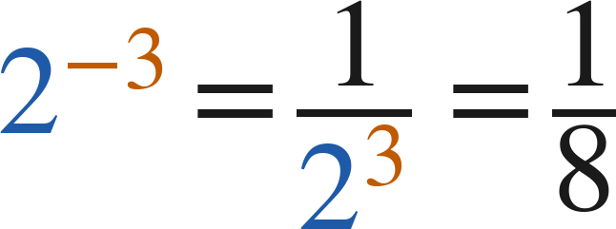
Notes
I. The pattern keeps going past zero
2⁴ | 2³ | 2² | 2¹ | 2⁰ | 2⁻¹ | 2⁻² | 2⁻³
16 | 8 | 4 | 2 | 1 | 1/2 | 1/4 | 1/8
Grade 7 Accelerated · Unit 3 · Lesson 4 — Negative Exponent Law
4

Slide 5
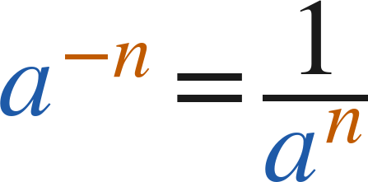
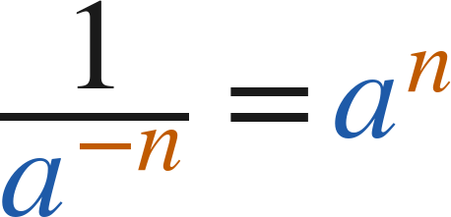

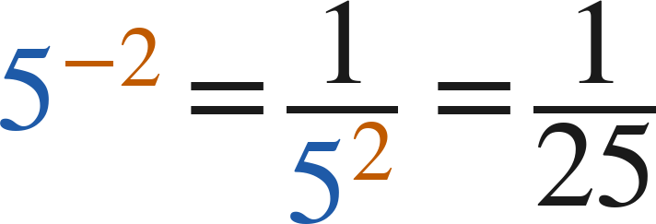
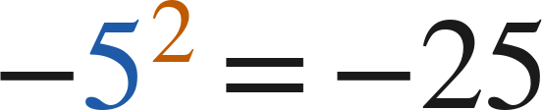
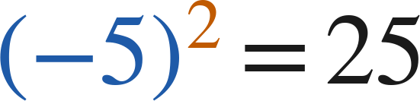
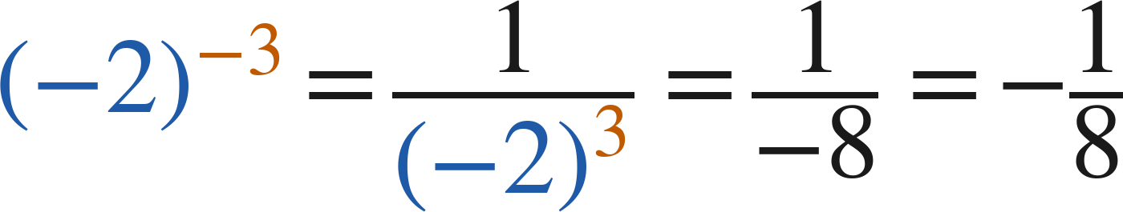
Notes
II. The negative exponent law
(
)
but
and
A negative exponent means reciprocal. It never means a negative value.
The base keeps its own sign:
Grade 7 Accelerated · Unit 3 · Lesson 4 — Negative Exponent Law
5

Slide 6

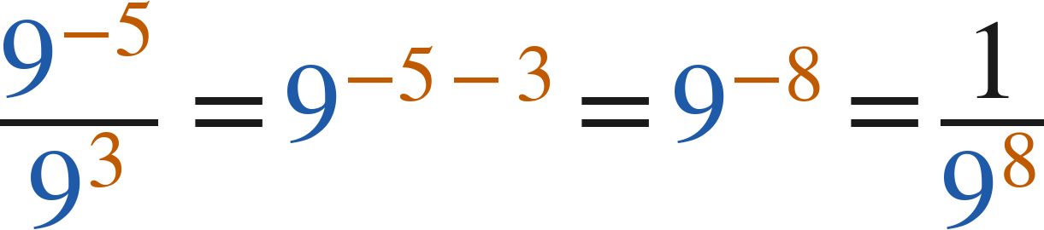
Notes
III. The laws still work with negative exponents
or
Add, subtract and multiply exponents exactly as before — the exponents are just integers now.
Grade 7 Accelerated · Unit 3 · Lesson 4 — Negative Exponent Law
6

Slide 7

Example 1
Rewrite with positive exponents, then find the value.
Grade 7 Accelerated · Unit 3 · Lesson 4 — Negative Exponent Law
7

Slide 8
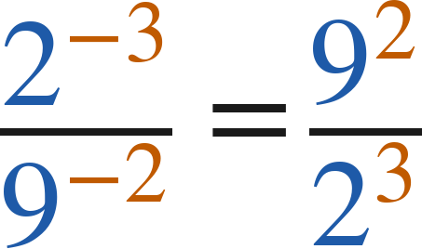
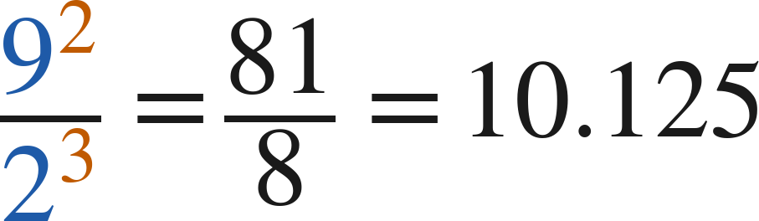
Example 1
Answer: 81/8 = 10.125
Grade 7 Accelerated · Unit 3 · Lesson 4 — Negative Exponent Law
8

Slide 9

Your Turn
Rewrite with positive exponents, then find the value.
Grade 7 Accelerated · Unit 3 · Lesson 4 — Negative Exponent Law
9

Slide 10
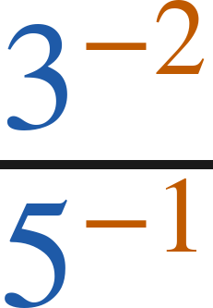

Your Turn
Rewrite with positive exponents, then find the value.
Answer:
Grade 7 Accelerated · Unit 3 · Lesson 4 — Negative Exponent Law
10

Slide 11

Example 2
Find the value.
Grade 7 Accelerated · Unit 3 · Lesson 4 — Negative Exponent Law
11

Slide 12
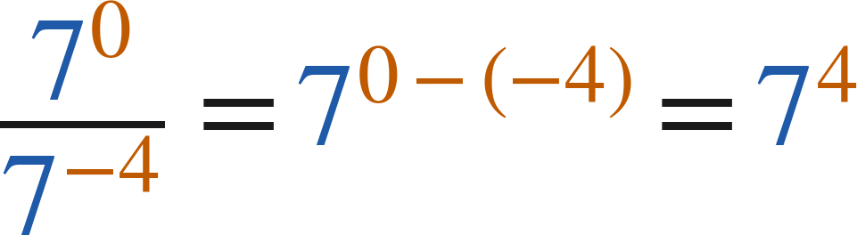
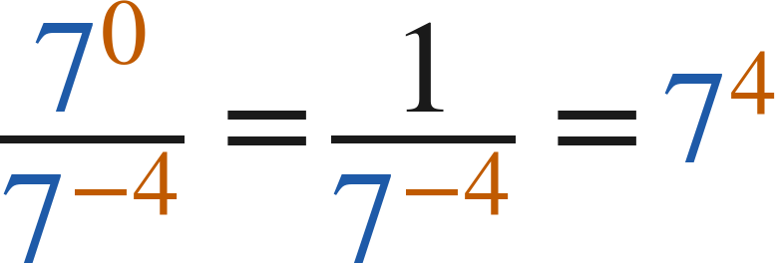

Example 2
Answer: 2,401
Grade 7 Accelerated · Unit 3 · Lesson 4 — Negative Exponent Law
12

Slide 13

Your Turn
Find the value.
Grade 7 Accelerated · Unit 3 · Lesson 4 — Negative Exponent Law
13

Slide 14
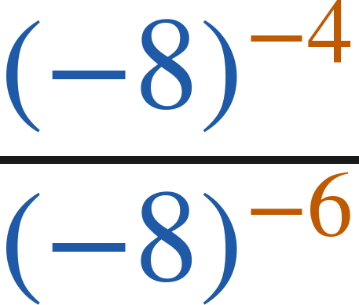
Your Turn
Find the value.
Answer: 64
Grade 7 Accelerated · Unit 3 · Lesson 4 — Negative Exponent Law
14

Slide 15

Whiteboards · Question 1 of 9
Answer it.
Grade 7 Accelerated · Unit 3 · Lesson 4 — Negative Exponent Law
15

Slide 16
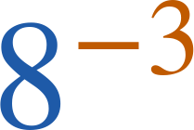

Whiteboards · Question 1 of 9
Answer:
Grade 7 Accelerated · Unit 3 · Lesson 4 — Negative Exponent Law
16

Slide 17
Whiteboards · Question 2 of 9
A sheet of paper 30 centimeters long is folded in half 7 times.
Each fold makes the top layer half as big.
What fraction of the whole sheet is the top layer after 7 folds?
Answer it.
Grade 7 Accelerated · Unit 3 · Lesson 4 — Negative Exponent Law
17

Slide 18
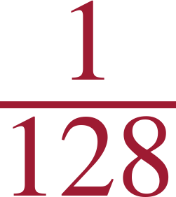
Whiteboards · Question 2 of 9
A sheet of paper 30 centimeters long is folded in half 7 times.
Each fold makes the top layer half as big.
What fraction of the whole sheet is the top layer after 7 folds?
Answer:
Grade 7 Accelerated · Unit 3 · Lesson 4 — Negative Exponent Law
18

Slide 19

Whiteboards · Question 3 of 9
Answer it.
Grade 7 Accelerated · Unit 3 · Lesson 4 — Negative Exponent Law
19

Slide 20
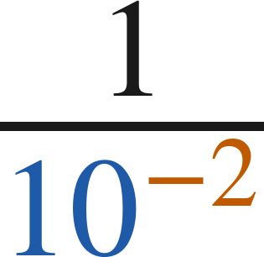
Whiteboards · Question 3 of 9
Answer: 10² = 100
Grade 7 Accelerated · Unit 3 · Lesson 4 — Negative Exponent Law
20

Slide 21

Whiteboards · Question 4 of 9
Answer it.
Grade 7 Accelerated · Unit 3 · Lesson 4 — Negative Exponent Law
21

Slide 22
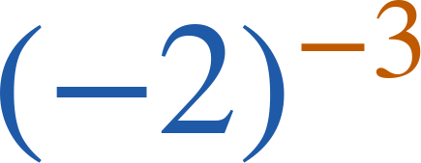

Whiteboards · Question 4 of 9
Answer:
Grade 7 Accelerated · Unit 3 · Lesson 4 — Negative Exponent Law
22

Slide 23

Whiteboards · Question 5 of 9
Which is the value?
A. 1/10
B. 1/25
C. −25
D. −10
Answer it.
Grade 7 Accelerated · Unit 3 · Lesson 4 — Negative Exponent Law
23

Slide 24
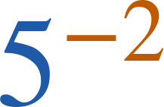
Whiteboards · Question 5 of 9
Which is the value?
A. 1/10
B. 1/25
C. −25
D. −10
Answer: B — 1/25
Grade 7 Accelerated · Unit 3 · Lesson 4 — Negative Exponent Law
24

Slide 25

Whiteboards · Question 6 of 9
Which expression is equivalent?
A. 6⁻¹⁰
B. 36³
C. 6⁻⁷
D. 6³
Answer it.
Grade 7 Accelerated · Unit 3 · Lesson 4 — Negative Exponent Law
25

Slide 26

Whiteboards · Question 6 of 9
Which expression is equivalent?
A. 6⁻¹⁰
B. 36³
C. 6⁻⁷
D. 6³
Answer: D — 6³
Grade 7 Accelerated · Unit 3 · Lesson 4 — Negative Exponent Law
26

Slide 27

Whiteboards · Question 7 of 9
Answer it.
Grade 7 Accelerated · Unit 3 · Lesson 4 — Negative Exponent Law
27

Slide 28
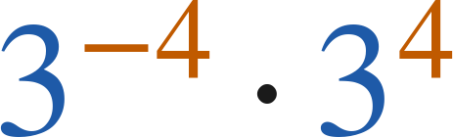
Whiteboards · Question 7 of 9
Answer: 1
Grade 7 Accelerated · Unit 3 · Lesson 4 — Negative Exponent Law
28

Slide 29

Whiteboards · Question 8 of 9
Answer it.
Grade 7 Accelerated · Unit 3 · Lesson 4 — Negative Exponent Law
29

Slide 30
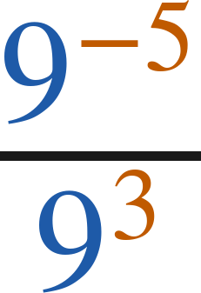

Whiteboards · Question 8 of 9
Answer:
Grade 7 Accelerated · Unit 3 · Lesson 4 — Negative Exponent Law
30

Slide 31

Whiteboards · Question 9 of 9
Ellen says the value of
is −25.
Explain why she is wrong, and show the correct value.
Write your answer in sentences.
Grade 7 Accelerated · Unit 3 · Lesson 4 — Negative Exponent Law
31

Slide 32
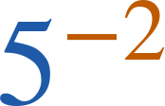
Whiteboards · Question 9 of 9
Ellen says the value of
is −25.
Explain why she is wrong, and show the correct value.
Answer: 5⁻² = 1/5² = 1/25
Grade 7 Accelerated · Unit 3 · Lesson 4 — Negative Exponent Law
32

Slide 33


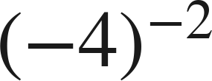
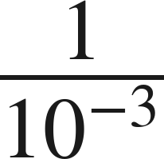

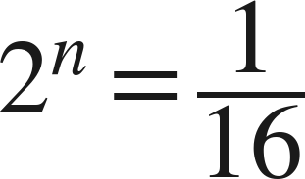

Independent Set
1.
Rewrite with a positive exponent. Do not evaluate.
2.
Find the value.
3.
Find the value.
4.
Find the value.
5.
Find the value.
6.
Find the value of
.
Grade 7 Accelerated · Unit 3 · Lesson 4 — Negative Exponent Law
33

Slide 34
IXL
1.
Open IXL and start today's skills.
2.
Work on paper where the question needs work. The answer box does not show it.
3.
Every skill listed is required, to a SmartScore of 67. Due at the start of the next class.
Today's skills — all required
Understanding negative exponents — YBB
Evaluate powers with negative exponents — WGS
Grade 7 Accelerated · Unit 3 · Lesson 4 — Negative Exponent Law
34

